Slide 1
Molecular Biology Biol 480
Lecture 31 April 15th , 2019

Slide 2
Announcements/Assignments
Lab quiz 2 on Wednesday---Tips handout.
Let’s make a schedule for presentations:
April 24th
May 1

Slide 3
Where were we?...Gene expression regulation in Eukaryotes
GAL gene cluster---Similar to operons in prokarytotes
Regulatory regions were recognized by finding regions of consistently ”open chromatin”. How? What is “open chromatin”? What is the connection to gene expression?
How is the GAL gene cluster regulated?

Slide 4
Regulatory region for both GAL10 and GAL1
Figure 18.16a
Notes:
Figure 18-16a Model of GAL1 and GAL10 UAS structures showing the binding sites for the Gal4p positive regulator and their interaction with the Gal80p negative regulator. Induction is shown as the structure of the Gal80p becomes altered, exposing the activation domain of Gal4p.

Slide 5
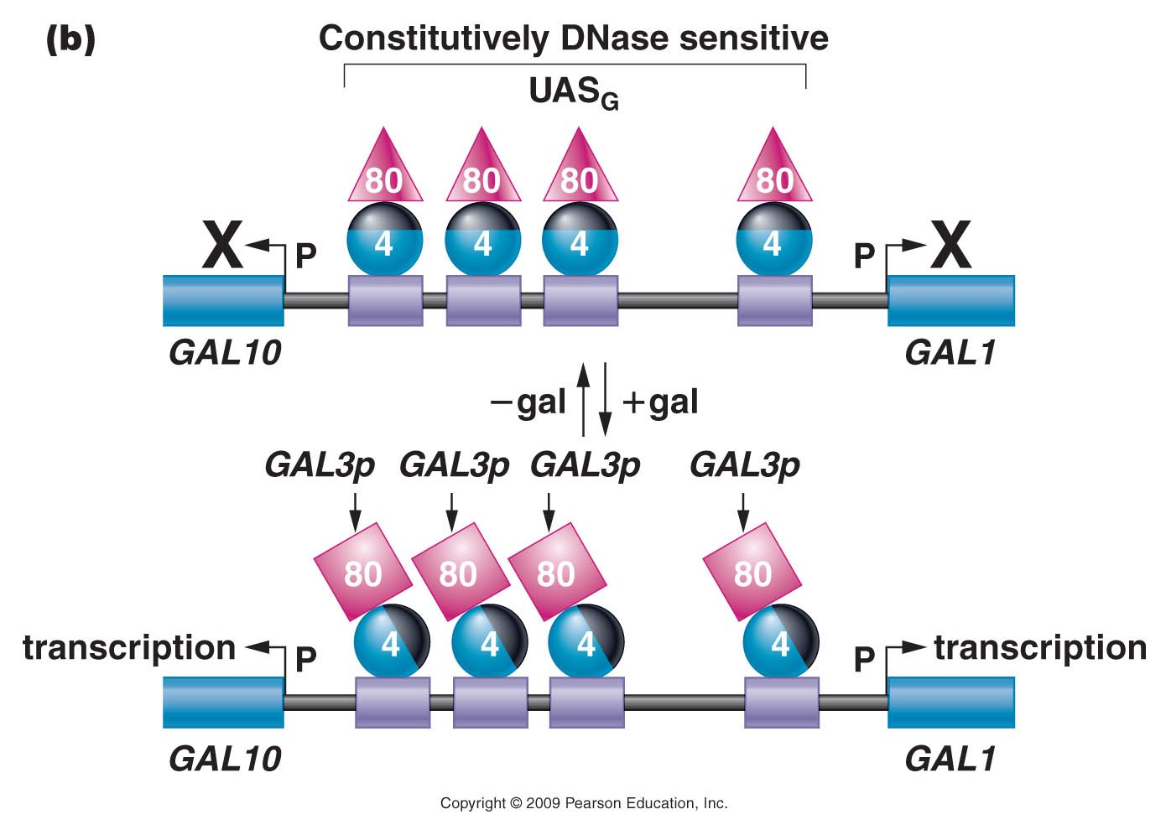
Figure 18.16b
Notes:
Figure 18-16b Model of GAL1 and GAL10 UAS structures showing the binding sites for the Gal4p positive regulator and their interaction with the Gal80p negative regulator. Induction is shown as the structure of the Gal80p becomes altered, exposing the activation domain of Gal4p.

Slide 6
Figure 18.16b
Notes:
Figure 18-16b Model of GAL1 and GAL10 UAS structures showing the binding sites for the Gal4p positive regulator and their interaction with the Gal80p negative regulator. Induction is shown as the structure of the Gal80p becomes altered, exposing the activation domain of Gal4p.

Slide 7
Say you come across a yeast strain that seems to NOT be inducible by galactose…what could be wrong?
Say you come across a yeast strain that seems to be constitutively expressing GAL1 and GAL10…What could be wrong?

Slide 8
2 primary examples of gene regulation in Eukaryotes
1. Single cell eukaryotes responding to changes in available nutrients, environmental conditions, biosynthetic demands---similar to prokaryotes.
2. Multicellular organisms—
Development depends on an ever changing program of gene expression
Ebryonic stem cells—Totipotent in terms of gene expession
Embryonic tissues
Cell-type specific specialization/differentiation
Some cellular response to basic environmental conditions (Same as above)

Slide 9
The central dogma says that genes encode RNA and proteins.
But the path to active RNA and proteins takes many steps/factors.
Access to DNA where the gene is located
Transcription of the gene
Post transcriptional processing of the RNA transcript
Export from the nucleus
Translation (if protein encoding gene)
Posttranslational modifications
All steps are themselves points of regulation of gene expression

Slide 10
Example of transcriptional regulation of cell type specific transcription is ---MyoD
MyoD is one of the important proteins that pushes a cell to differentiate into a muscle cell.
MyoD gene encodes a protein that IS a transcription factor. It belongs to a family of proteins called myogenic regulators.
The myoD protein has a DNA binding motif called a basic helix-loop-helix motif. Myo D binds to regulatory regions of other genes---genes that encode proteins the contribute to the function of muscle cells.
http://en.wikipedia.org/wiki/MyoD

Slide 11
MyoD plays a role in removing/deactivating proteins that tighten chromatin structure and helps recruit transcription factors to muscle-specific gene promoters.

Slide 12
Myo D
Regulatory sequence of a gene needed for muscle function

Slide 13
The presence of MyoD in a cell pushes it to express genes with MyoD binding sites in their promoters.
Even though all your genes are present in muscle cells …only proteins needed in muscle are encoded by genes with MyoD-binding promoters.

Slide 14
How do cells acquire MyoD?
Myo D gene expression (transcription) is activated by muscle activity and tissue damage. Replacement of damaged muscle depends on new muscle cells making muscle-specific proteins.
Much work on Myo D has been done in an attempt to understand and find treatment for Muscular Dystrophy.
Why? Understanding muscle cell differentiation is essential in understanding muscle-related diseases…MD represents a “mutant” form of muscle cell function.

Slide 15
Excellent summary!
https://www.khanacademy.org/science/biology/gene-regulation/gene-regulation-in-eukaryotes/a/overview-of-eukaryotic-gene-regulation
https://www.khanacademy.org/science/biology/gene-regulation/gene-regulation-in-eukaryotes/a/eukaryotic-transcription-factors

Slide 16
What about gene silencing?
Some gene regulation involves inhibiting or reducing the level of transcription. For example some transcription factors act in an inhibitory fashion by epigenetic modifications, physically blocking promoter regions or competing with positive transcription factors.
Some gene regulation involves inhibiting or reducing the initiation or rate of translation.
Fairly recently, we have come to understand that special, RNA-based systems are sometimes used for gene silencing.

Slide 17
For example?
RNA interference. This was a totally unexpected mechanism for a cell to destroy RNAs in a sequence specific mechanism.
It is thought to be an evolutionarily conserved mechanism for eliminating invading nucleic acids such as RNA viruses.

Slide 18
RNAi was shown to be the underlying mechanism for loss of pigment production in cells of petunia flowers.
http://www.oxbridgebiotech.com/review/science-basics/nobel-prize-2006-from-petunias-to-potential-cure-all-in-the-discovery-of-rna-interference/

Slide 19
Andrew Fire and Craig Mello first described RNA interference (RNAi) using the model organism (nematode worm), Caenorhabditis elegans.
They won a Nobel Prize in 2006 for their work.

Slide 20
Potentially from a virus
Potentially from a virus
Preventing viral protein from being translated

Slide 21
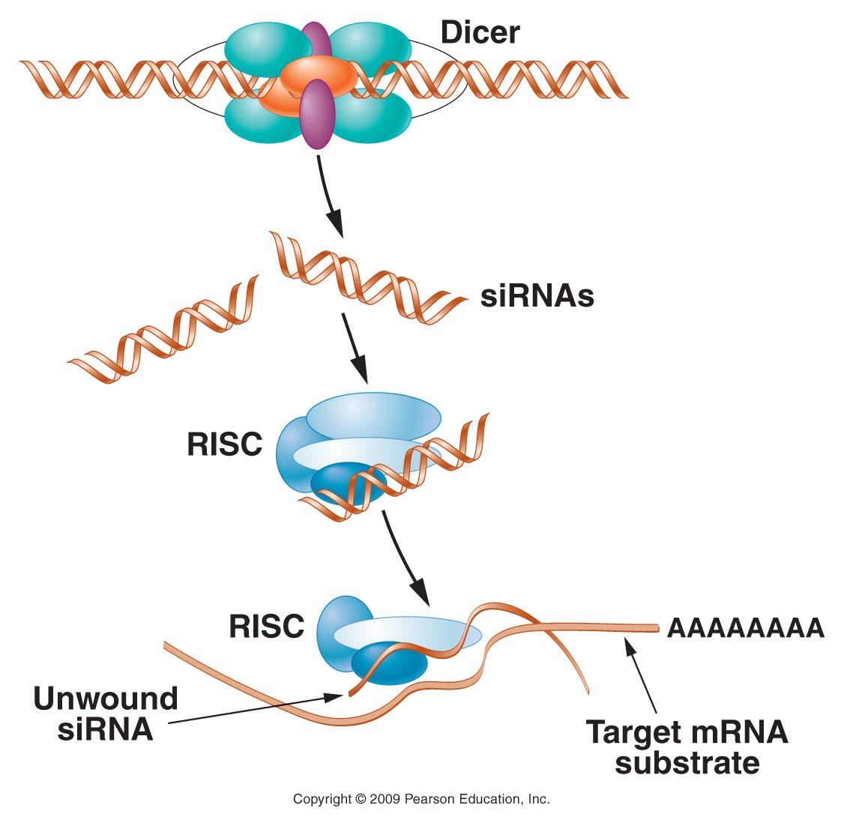
Figure 18.23
Notes:
Figure 18-23 The action of Dicer and RISC (RNA-induced silencing complex). Dicer, a multisubunit complex, binds to double-stranded RNA molecules and cleaves them into ~21-nucleotide molecules called small interfering RNAs (siRNAs). These bind to a multiprotein RISC complex and are unwound to form single-stranded molecules that target mRNAs with complementary sequences, marking them for degradation by RISC.

Slide 22
This is a post-transcriptional regulation. (RNA is destroyed, but not prevented from being made).
A second RNA-based post-transcriptional regulatory mechanism uses cellular small RNAs called micro RNAs (miRNA) to regulate how much of specific proteins are made.
More than 1500 miRNAs have been identified in the regulation of human gene expression

Slide 23
miRNA
miRNAs are encoded by miRNA genes of plants, animals, and some viruses (not cut from invading RNA)
They are small (22 nucleotides) sequences, some of which are complementary to longer mRNA sequences.
They silence genes in several ways.

Slide 24
Action of miRNAs
1.bind to and cleave mRNA
2. bind to and inhibit translation of mRNA
3. bind to and decrease the stability of mRNA
Humans encode an estimated 1000 different miRNAs which regulate about 60% of the human genome.

Slide 25
miRNA action

Slide 26
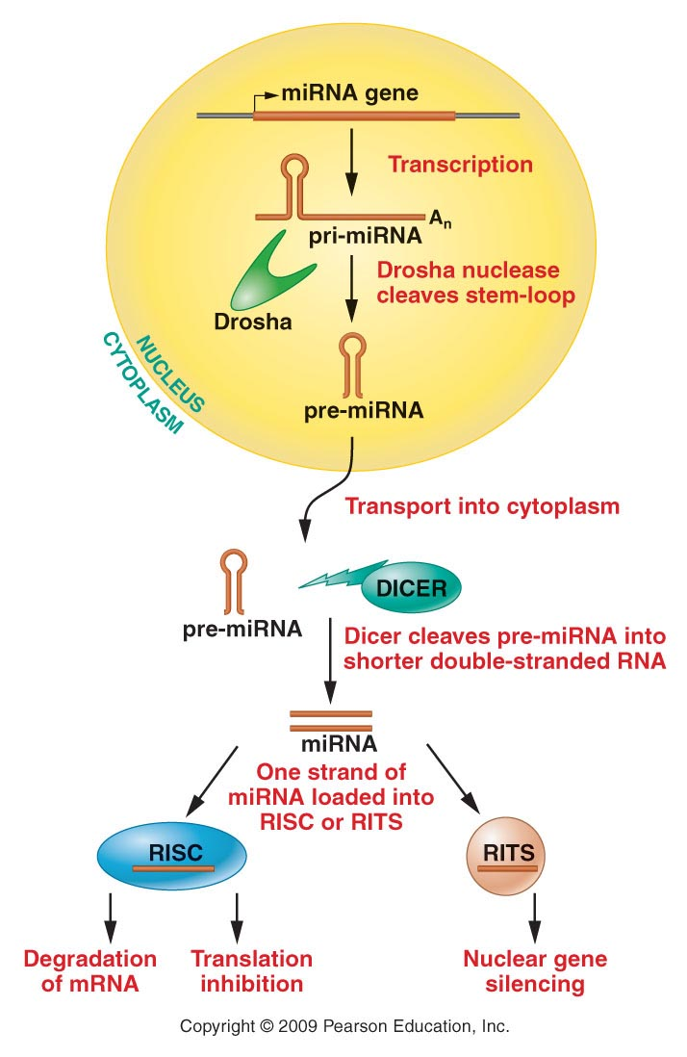
Figure 17-14
Figure 18.24
Notes:
Figure 18-24 Pathways of miRNA-mediated gene silencing. miRNAs are transcribed and processed in the nucleus, then exported to the cytoplasm to enter the siRNA pathways of gene silencing.

Slide 27
Other control points for gene expression.
What happens to eukaryotic mRNA after transcription? Usually splicing!

Slide 28
Recall, anything that inhibits or speeds splicing will affect rate of production of an active protein.
Alternative splicing is a great example of how splicing can significantly change what type of protein is translated.

Slide 29
Your book uses a great example of the calcitonin gene mRNA that gets sliced alternatively in 2 cell types. The protein(s) produced regulate different things in different cell types.
STUDY figure 17-11!

Slide 30
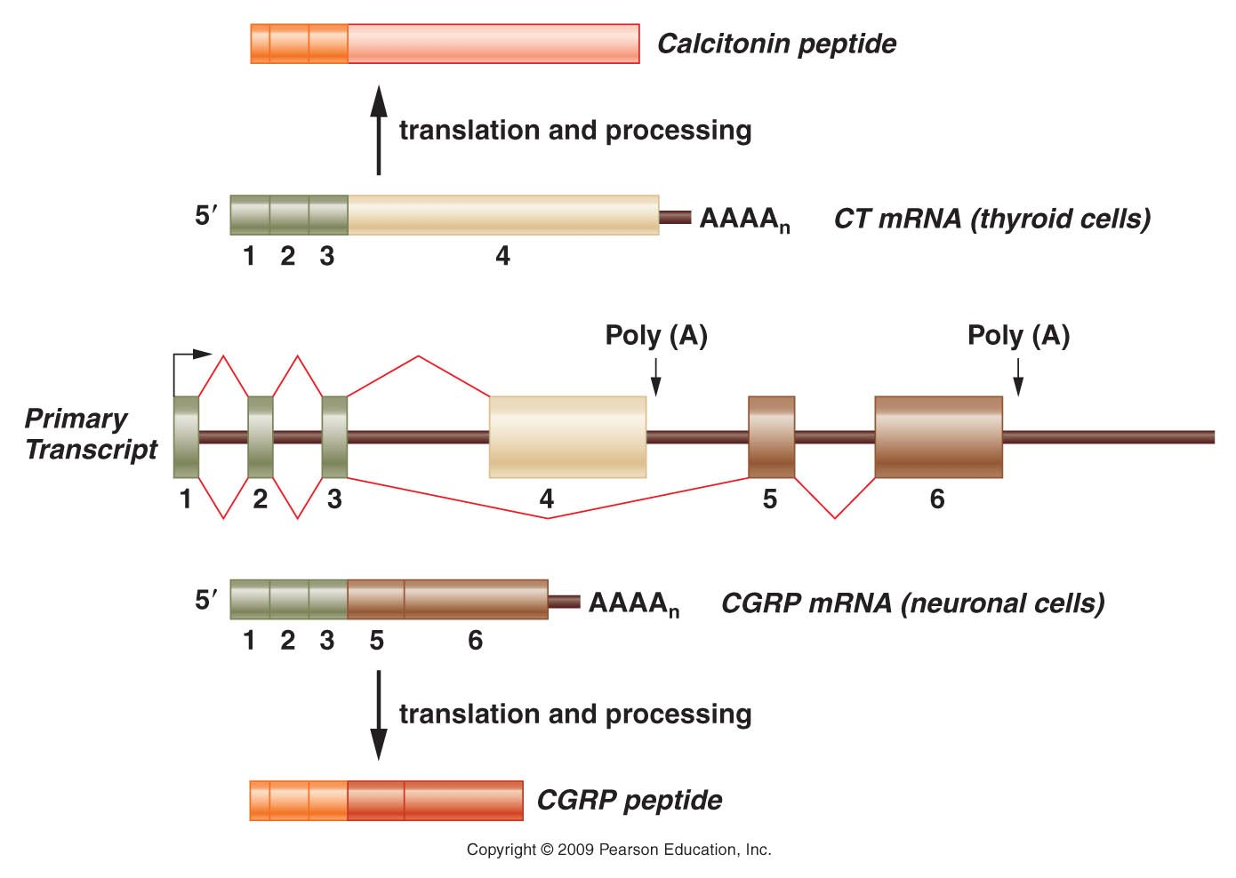
Figure 18.18
Notes:
Figure 18-18 Alternative splicing of the CT/CGRP gene transcript. The primary transcript, which is shown in the middle of the diagram, contains six exons. The primary transcript can be spliced into two different mRNAs, both containing the first three exons but differing in their final exons. The CT mRNA contains exon 4, with polyadenylation occurring at the end of the fourth exon. The CGRP mRNA contains exons 5 and 6, and polyadenylation occurs at the end of exon 6. The CT mRNA is produced in thyroid cells. After translation, the resulting protein is processed into the calcitonin peptide. In contrast, the CGRP mRNA is produced in neuronal cells, and after translation, its protein product is processed into the CGRP peptide.

Slide 31
Recall…alternative splicing is thought to be one mechanism to explain the relatively low number of genes (25,000) found when the human genome was sequenced…
Those 25K genes likely econde .5-2 million proteins.
The proteins made in a specific cell is known as its proteome.

Slide 32
One of the most extreme cases of alternative splicing is observed in the fruit fly---Drosophila melanogaster.
A gene called Dscam encodes (a) protein needed for neuron connections.

Slide 33
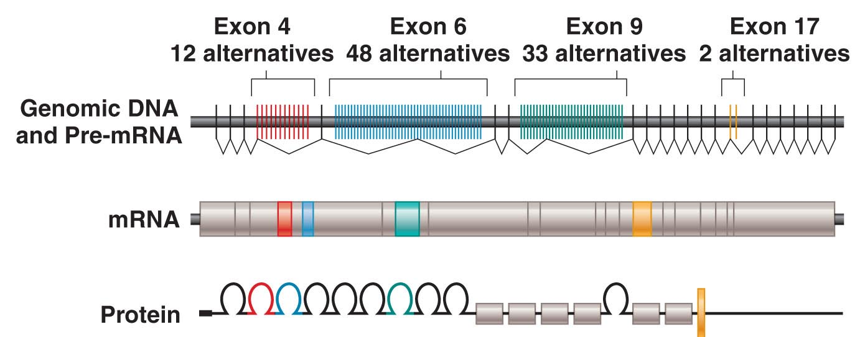
Figure 18.19
Notes:
Figure 18-19 Alterntive splicing of the Dscam gene mRNA. (Top) Organization of the Dscam gene in Drosophila melanogaster and the transcribed pre-mRNA. Each mRNA will contain one of the 12 possible exons for exon 4 (red), one of the 48 possible exons for exon 6 (blue), one of 33 for exon 9 (green), and one of 2 for exon 17 (yellow). If all possible combinations of these exons are used, the Dscam gene can encode 38,016 different versions of the DSCAM protein.

Slide 34
The entire Drosophila genome encodes ~13,000 proteins.
Alternative splicing allows Drosophila to make over 38,000 forms (isoforms) of the Dscam protein!

